Slide 1
Describe Azure Service Level agreements

Slide 2
Agenda
Service Level Agreement (SLA)
Determine the SLA for a particular Azure product or service

Slide 3
Service level agreement (SLA)
SLAs establish specific targets for availability, and they also define what the service provider will do when those targets aren’t met. SLAs are expressed as a percentage and are almost always 99% or higher. The highest level of availability expressed in an SLA is 99.999%, commonly referred to as 5 nines.
A service with an SLA of 5 nines guarantees that downtime over an entire year will not exceed 5.56 minutes. A more reasonable SLA of 99.9% guarantees that downtime over the period of a month will not exceed 43.2 minutes.
For details on SLA levels and maximum downtime allowed within the SLA, see: https://docs.microsoft.com/azure/architecture/resiliency/#slas.
Because SLAs only refer to problems within control of the cloud provider, when an application suffers from lack of availability, it’s important to determine whether the problem is a platform issue or an issue with your code or configuration. Answering that question can be more difficult than you might think.
If you report that your App Service application is unavailable, Microsoft needs to determine whether that’s a problem on their end or a problem with your application.

Slide 4
Service level agreement (SLA)
If you report that your App Service application is unavailable, Microsoft needs to determine whether that’s a problem on their end or a problem with your application.
Microsoft maintains an enormous amount of diagnostic data on all Azure operations across all Azure services. When you open a support case with Microsoft to report that your application is unavailable, Microsoft can perform data analytics against this data to determine if there was a problem with the Azure platform itself.
If you believe that your application’s availability has fallen below the SLA, it’s your responsibility to submit a claim to Microsoft. You can do that by opening a support case. If Microsoft determines that the SLA has not been met, you may receive a credit on your Azure invoice. The amount of the credit depends on the duration that SLA was not met and the specific Azure service’s SLA policy.
Notes:
In order to be eligible for a credit due to a failure to meet SLA, you must submit a claim to Microsoft within two months of the end of the billing cycle during which the downtime occurred.

Slide 5
Agenda
Service Level Agreement (SLA)
Determine the SLA for a particular Azure product or service

Slide 6
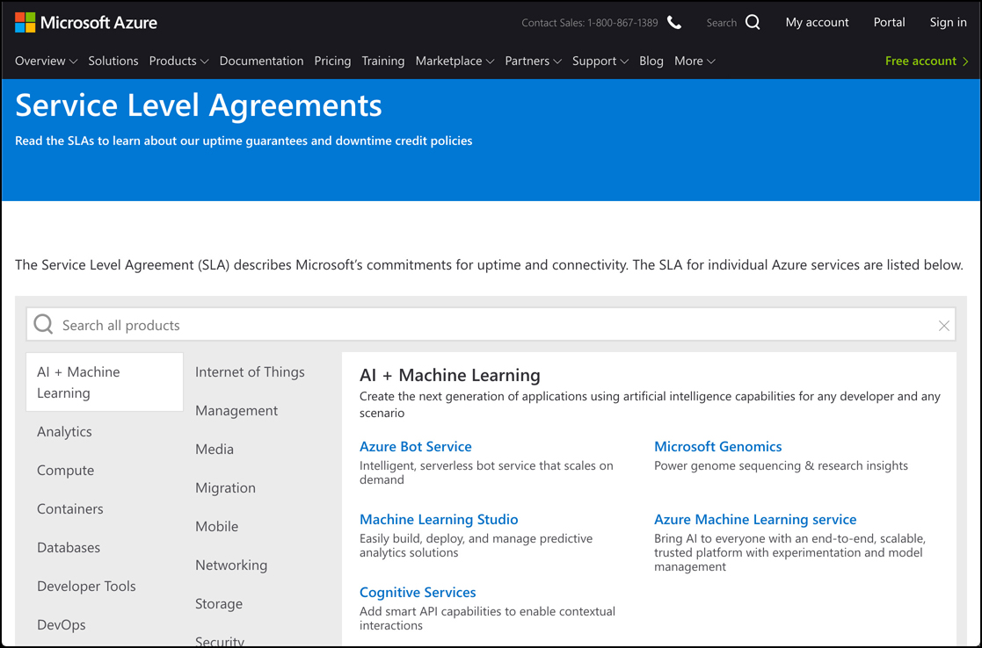
Determine the SLA for a particular Azure product or service
Because SLA varies between Azure services, and because specific configurations can impact the SLA of a single Azure service, it’s important to be able to determine the specific SLA for the Azure services you are using. Microsoft provides a web page that has details on the SLA for every Azure service. You can find it at: https://azure.microsoft.com/en-us/support/legal/sla

Slide 7
Determine the SLA for a particular Azure product or service
Once on the SLA web page, you can select a category to see all Azure services in that category. You can also enter your service name in the search box to find the SLA for that service. When you click on a service, you’ll see details on the SLA provided by that service.
The SLA Details section applies to the specific Azure service you’re viewing. For example, this section on the VM SLA page defines VM-specific terms that relate to the SLA for VMs.
If your application uses multiple Azure services, multiple SLAs will apply to you. If you experience downtime, you must submit a claim for all Azure services that fell below SLA if you want to be considered for a credit.
When calculating the SLA for an application using multiple Azure services, you must calculate a composite SLA based on the services you’re using. For example, if you have an App Service Web App that also uses a single Azure VM using Premium storage, you have to combine the SLA for both services to determine your application’s overall SLA.
Notes:
The SLA for App Service is 99.95%, and the SLA for a single VM running Premium storage is 99.9%. Therefore, your overall SLA for your application is 99.95% x 99.9%, or 99.85%. By deploying two VMs into two availability zones in the same region, you can obtain a 99.99% SLA for your VMs, and that increases your overall SLA to 99.94%.

